Slide 1
Stacks
Chapter 5
Data Structures and Abstractions with Java, 4e
Frank Carrano
© 2015 Pearson Education, Inc., Upper Saddle River, NJ. All rights reserved.

Slide 2
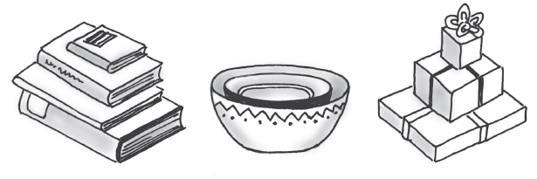
Stacks
FIGURE 5-1 Some familiar stacks
Add item on top of stack
Remove item that is topmost
  Last In, First Out … LIFO
© 2015 Pearson Education, Inc., Upper Saddle River, NJ. All rights reserved.

Slide 3
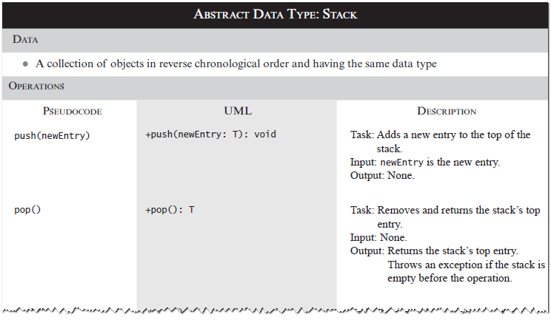
Specifications of the ADT Stack
© 2015 Pearson Education, Inc., Upper Saddle River, NJ. All rights reserved.

Slide 4
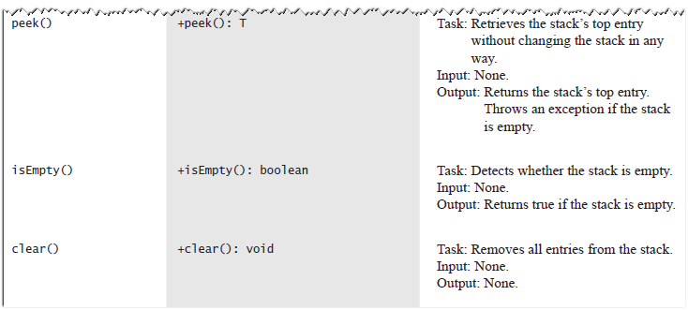
Specifications of the ADT Stack
© 2015 Pearson Education, Inc., Upper Saddle River, NJ. All rights reserved.

Slide 5
Design Decision
When stack is empty
  What to do with pop and peek?
Possible actions
  Assume that the ADT is not empty;
  Return null.
  Throw an exception (which type?).
© 2015 Pearson Education, Inc., Upper Saddle River, NJ. All rights reserved.

Slide 6
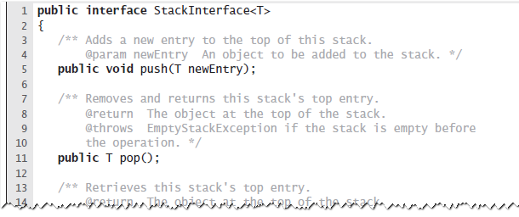
Interface
LISTING 5-1 An interface for the ADT stack
© 2015 Pearson Education, Inc., Upper Saddle River, NJ. All rights reserved.

Slide 7
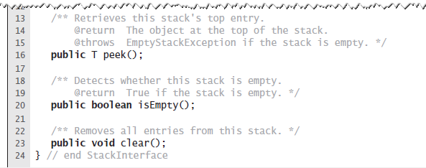
Interface
LISTING 5-1 An interface for the ADT stack
© 2015 Pearson Education, Inc., Upper Saddle River, NJ. All rights reserved.

Slide 8
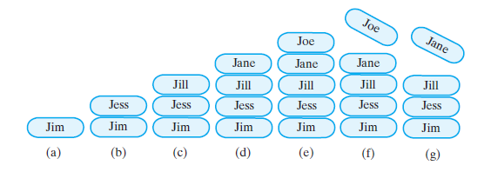
Example
FIGURE 5-2 A stack of strings after (a) push adds Jim; (b) push adds Jess; (c) push adds Jill; (d) push adds Jane; (e) push adds Joe; (f ) pop retrieves and removes Joe; (g) pop retrieves and removes Jane
© 2015 Pearson Education, Inc., Upper Saddle River, NJ. All rights reserved.

Slide 9
Security Note
Design guidelines
  Use preconditions and postconditions to document assumptions.
  Do not trust client to use public methods correctly.
  Avoid ambiguous return values.
  Prefer throwing exceptions instead of returning values to signal problem.
© 2015 Pearson Education, Inc., Upper Saddle River, NJ. All rights reserved.

Slide 10
Processing Algebraic Expressions
Infix: each binary operator appears between its operands a + b
Prefix: each binary operator appears before its operands + a b
Postfix: each binary operator appears after its operands a b +
Balanced expressions: delimiters paired correctly
© 2015 Pearson Education, Inc., Upper Saddle River, NJ. All rights reserved.

Slide 11
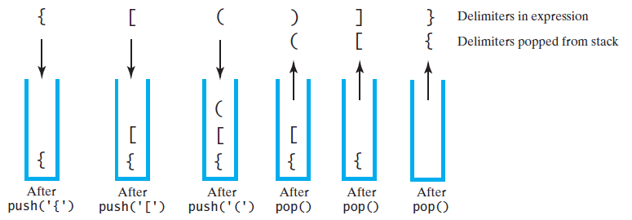
Processing Algebraic Expressions
FIGURE 5-3 The contents of a stack during the
scan of an expression that contains
the balanced delimiters { [ ( ) ] }
© 2015 Pearson Education, Inc., Upper Saddle River, NJ. All rights reserved.

Slide 12
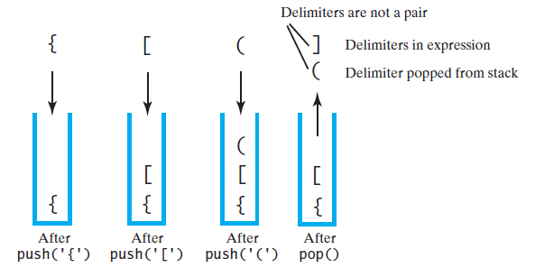
Processing Algebraic Expressions
FIGURE 5-4 The contents of a stack during the
scan of an expression that contains
the unbalanced delimiters { [ ( ] ) }
© 2015 Pearson Education, Inc., Upper Saddle River, NJ. All rights reserved.

Slide 13
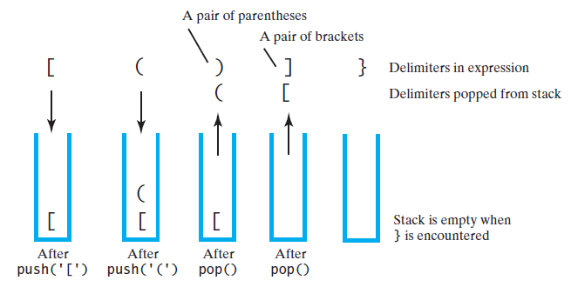
Processing Algebraic Expressions
FIGURE 5-5 The contents of a stack during the
scan of an expression that contains
the unbalanced delimiters [ ( ) ] }
© 2015 Pearson Education, Inc., Upper Saddle River, NJ. All rights reserved.

Slide 14
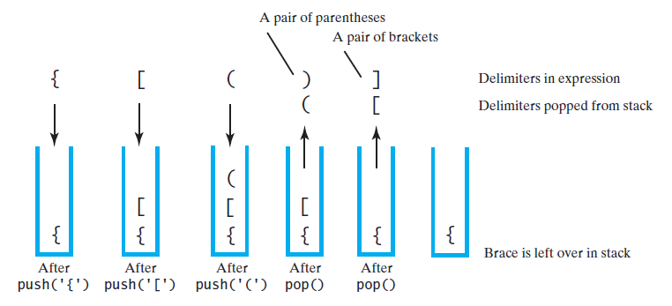
Processing Algebraic Expressions
FIGURE 5-6 The contents of a stack during the
scan of an expression that contains
the unbalanced delimiters { [ ( ) ]
© 2015 Pearson Education, Inc., Upper Saddle River, NJ. All rights reserved.

Slide 15
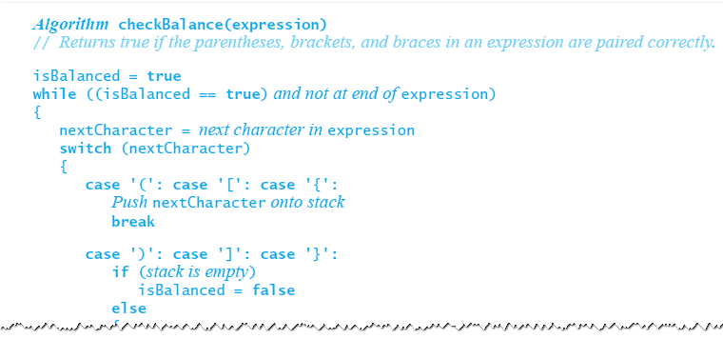
Processing Algebraic Expressions
Algorithm to process for balanced expression.
© 2015 Pearson Education, Inc., Upper Saddle River, NJ. All rights reserved.

Slide 16
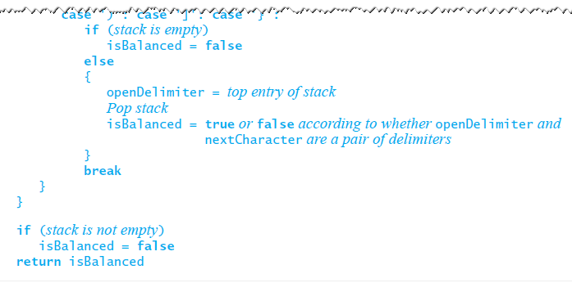
Processing Algebraic Expressions
Algorithm to process for balanced expression.
© 2015 Pearson Education, Inc., Upper Saddle River, NJ. All rights reserved.

Slide 17
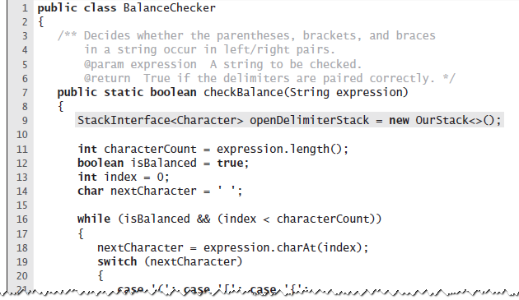
Java Implementation
LISTING 5-2 The class BalanceChecker
© 2015 Pearson Education, Inc., Upper Saddle River, NJ. All rights reserved.

Slide 18
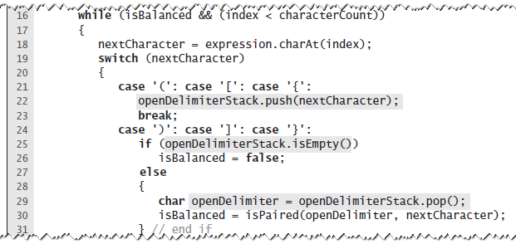
Java Implementation
LISTING 5-2 The class BalanceChecker
© 2015 Pearson Education, Inc., Upper Saddle River, NJ. All rights reserved.

Slide 19
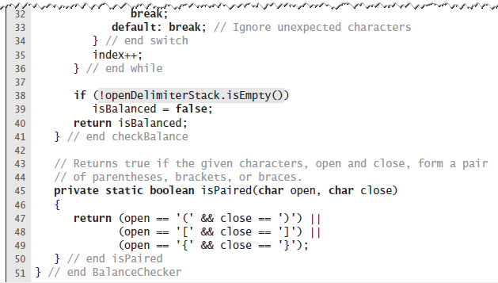
Java Implementation
LISTING 5-2 The class BalanceChecker
© 2015 Pearson Education, Inc., Upper Saddle River, NJ. All rights reserved.

Slide 20
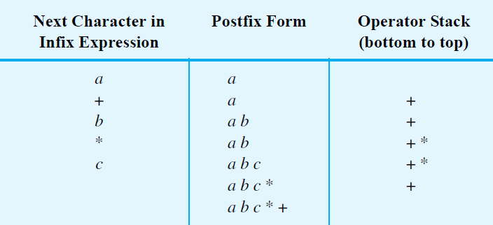
Infix to Postfix
FIGURE 5-7 Converting the infix expression
a + b * c to postfix form
© 2015 Pearson Education, Inc., Upper Saddle River, NJ. All rights reserved.

Slide 21
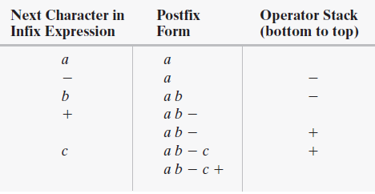
Successive Operators with Same Precedence
FIGURE 5-8 Converting an infix expression
to postfix form: (a) a - b + c;
© 2015 Pearson Education, Inc., Upper Saddle River, NJ. All rights reserved.

Slide 22
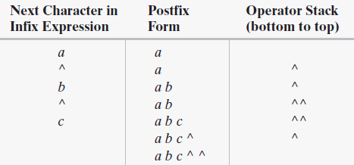
Successive Operators with Same Precedence
FIGURE 5-8 Converting an infix expression
to postfix form: a ^ b ^ c
© 2015 Pearson Education, Inc., Upper Saddle River, NJ. All rights reserved.

Slide 23
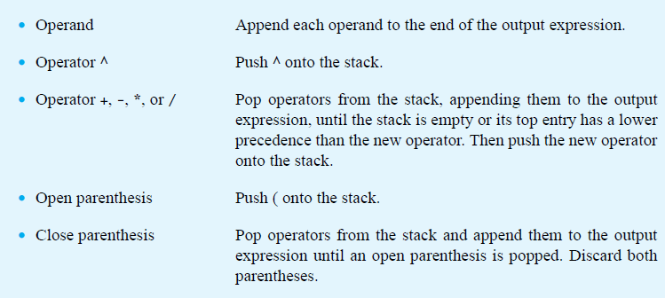
Infix-to-postfix Conversion
© 2015 Pearson Education, Inc., Upper Saddle River, NJ. All rights reserved.

Slide 24
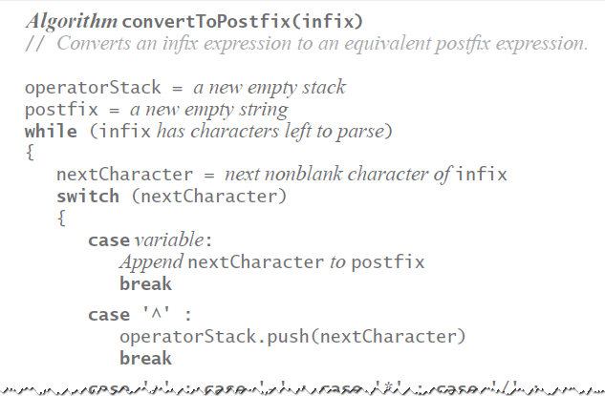
Infix-to-postfix Algorithm
© 2015 Pearson Education, Inc., Upper Saddle River, NJ. All rights reserved.

Slide 25
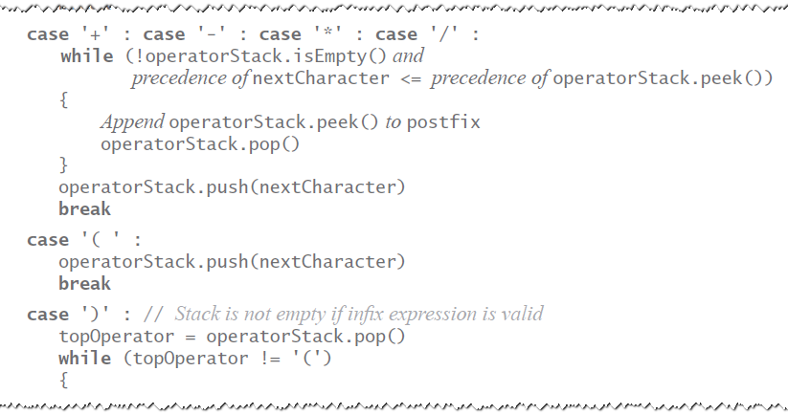
Infix-to-postfix Algorithm
© 2015 Pearson Education, Inc., Upper Saddle River, NJ. All rights reserved.

Slide 26
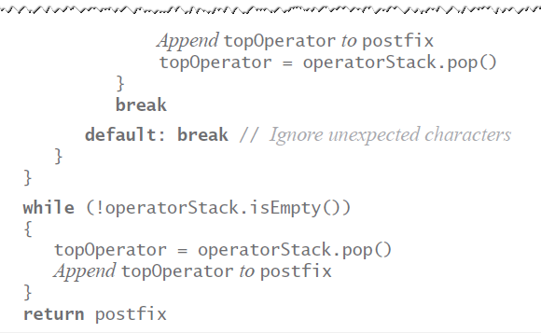
Infix-to-postfix Algorithm
© 2015 Pearson Education, Inc., Upper Saddle River, NJ. All rights reserved.

Slide 27
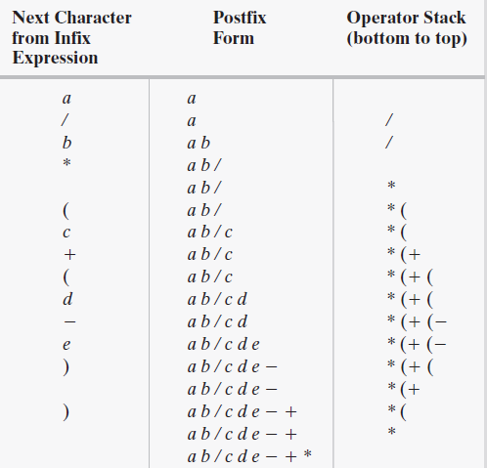
Infix to Postfix
FIGURE 5-9 The steps in converting the infix expression
a / b * (c + (d - e)) to postfix form
© 2015 Pearson Education, Inc., Upper Saddle River, NJ. All rights reserved.

Slide 28
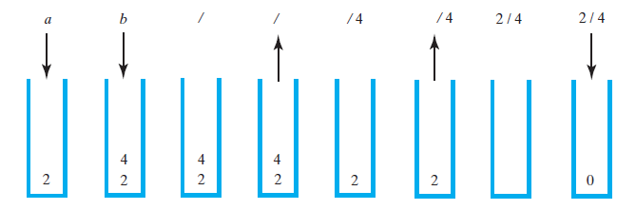
Evaluating Postfix Expressions
FIGURE 5-10 The stack during the evaluation of the postfix expression a b / when a is 2 and b is 4
© 2015 Pearson Education, Inc., Upper Saddle River, NJ. All rights reserved.

Slide 29
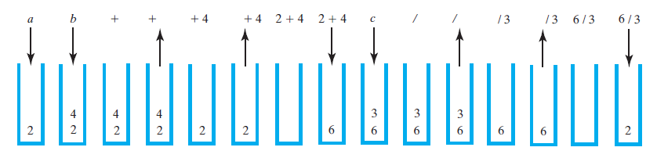
Evaluating Postfix Expressions
FIGURE 5-11 The stack during the evaluation of the postfix expression a b + c / when a is 2, b is 4, and c is 3
© 2015 Pearson Education, Inc., Upper Saddle River, NJ. All rights reserved.

Slide 30
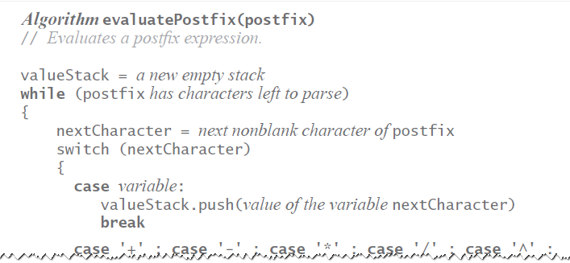
Evaluating Postfix Expressions
Algorithm for evaluating postfix expressions.
© 2015 Pearson Education, Inc., Upper Saddle River, NJ. All rights reserved.

Slide 31
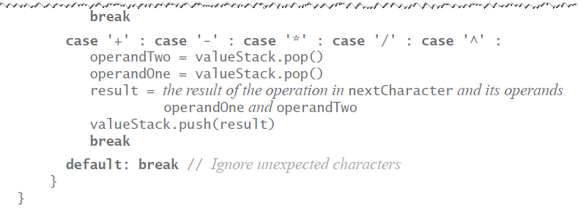
Evaluating Postfix Expressions
Algorithm for evaluating postfix expressions.
© 2015 Pearson Education, Inc., Upper Saddle River, NJ. All rights reserved.

Slide 32
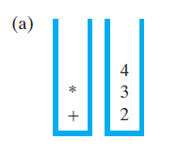
Evaluating Infix Expressions
FIGURE 5-12 Two stacks during the evaluation of
a + b * c when a is 2, b is 3, and c is 4:
(a) after reaching the end of the expression;
© 2015 Pearson Education, Inc., Upper Saddle River, NJ. All rights reserved.

Slide 33
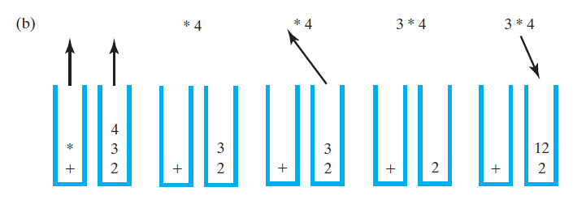
Evaluating Infix Expressions
FIGURE 5-12 Two stacks during the evaluation of
a + b * c when a is 2, b is 3, and c is 4:
(b) while performing the multiplication;
© 2015 Pearson Education, Inc., Upper Saddle River, NJ. All rights reserved.

Slide 34
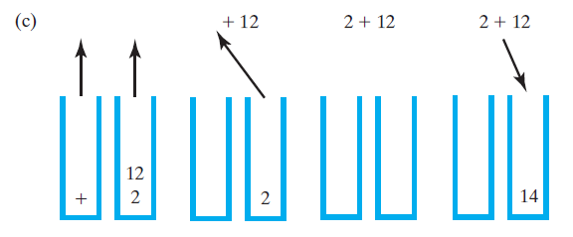
Evaluating Infix Expressions
FIGURE 5-12 Two stacks during the evaluation of
a + b * c when a is 2, b is 3, and c is 4:
(c) while performing the addition
© 2015 Pearson Education, Inc., Upper Saddle River, NJ. All rights reserved.

Slide 35
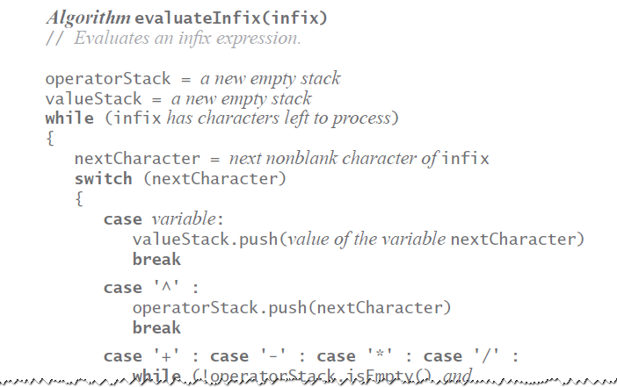
Evaluating Infix Expressions
Algorithm to evaluate infix expression.
© 2015 Pearson Education, Inc., Upper Saddle River, NJ. All rights reserved.

Slide 36
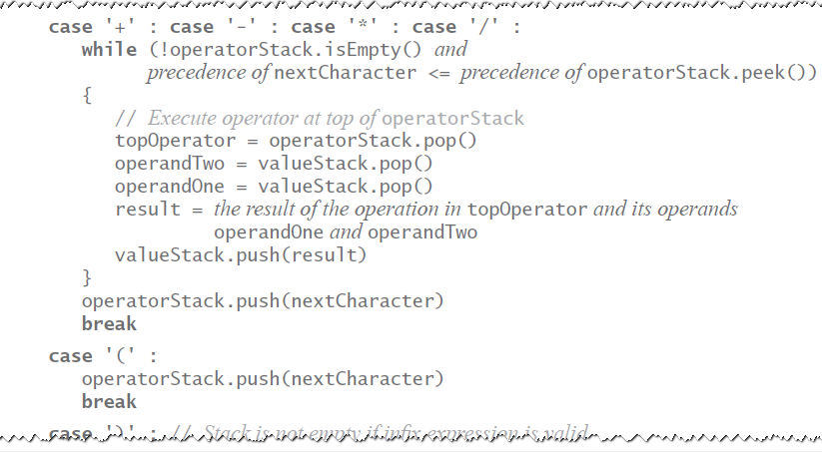
Evaluating Infix Expressions
Algorithm to evaluate infix expression.
© 2015 Pearson Education, Inc., Upper Saddle River, NJ. All rights reserved.

Slide 37
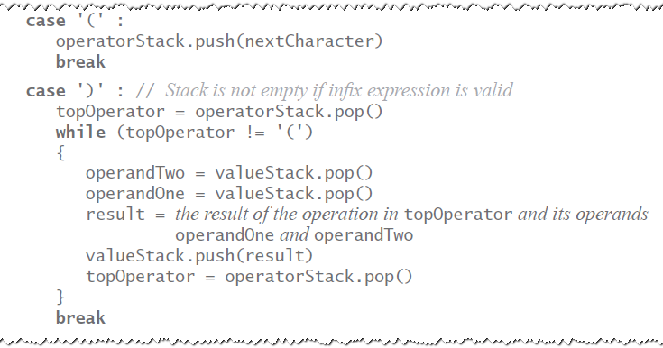
Evaluating Infix Expressions
Algorithm to evaluate infix expression.
© 2015 Pearson Education, Inc., Upper Saddle River, NJ. All rights reserved.

Slide 38
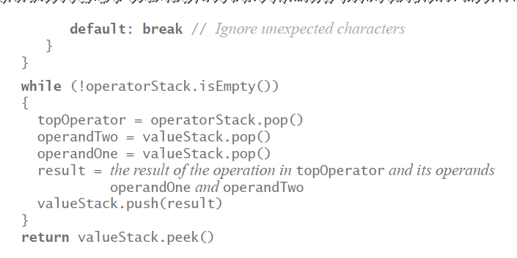
Evaluating Infix Expressions
Algorithm to evaluate infix expression.
© 2015 Pearson Education, Inc., Upper Saddle River, NJ. All rights reserved.

Slide 39
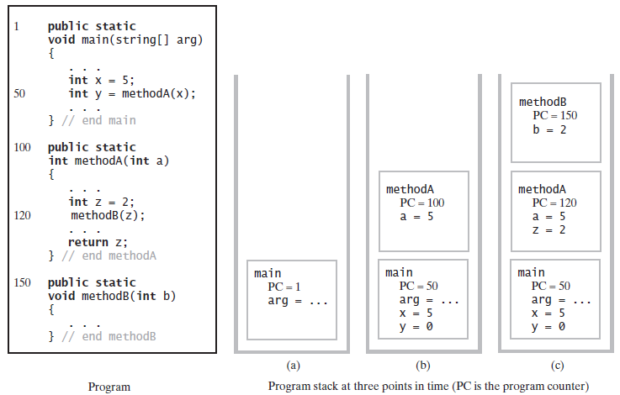
The Program Stack
FIGURE 5-13 The program stack at three points in time: (a) when main begins execution; (b) when methodA begins execution; (c) when methodB begins execution
© 2015 Pearson Education, Inc., Upper Saddle River, NJ. All rights reserved.

Slide 40
Java Class Library:
The Class Stack
  Found in java.util
Methods
  A constructor – creates an empty stack
  public T push(T item);
  public T pop();
  public T peek();
  public boolean empty();
© 2015 Pearson Education, Inc., Upper Saddle River, NJ. All rights reserved.

Slide 41
End
Chapter 5
© 2015 Pearson Education, Inc., Upper Saddle River, NJ. All rights reserved.

